Slide 1
BODY SYSTEM INTERACTIONS: Defense from injury & illness

Slide 2
BIOL.10A Describe the interactions that occur among systems that perform the functions of regulation, nutrient absorption, reproduction, and defense from injury or illness in animals.

Slide 3
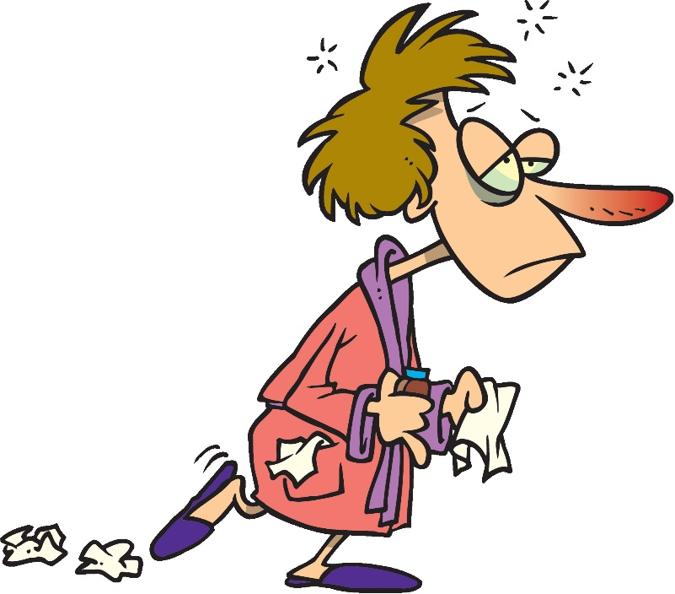
What can harm our bodies?
Viruses
Pathogenic bacteria
Parasites
Predators
Cuts/scrapes
Infections
STDs (sexually transmitted diseases)
Broken bone

Slide 4
DEFENSE FROM INJURY AND ILLNESS
ESSENTIAL QUESTION: What systems work together to protect our body and fight against illness.

Slide 5
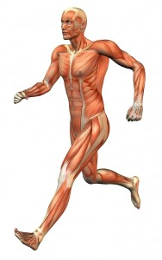
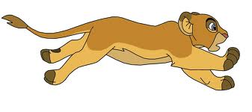
MUSCULAR SYSTEM
The muscular system moves our body to help us evade predators and avoid injury

Slide 6
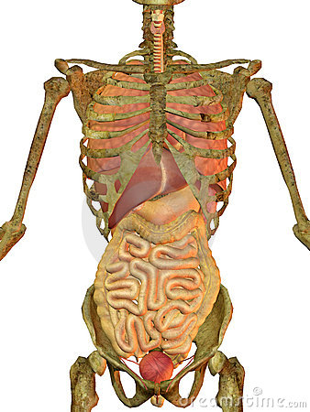
SKELETAL SYSTEM
Includes BONES
Bones are HARD and protect your SOFT vital organs from injury
Also gives you STRUCTURE so you can RUN away from danger

Slide 7
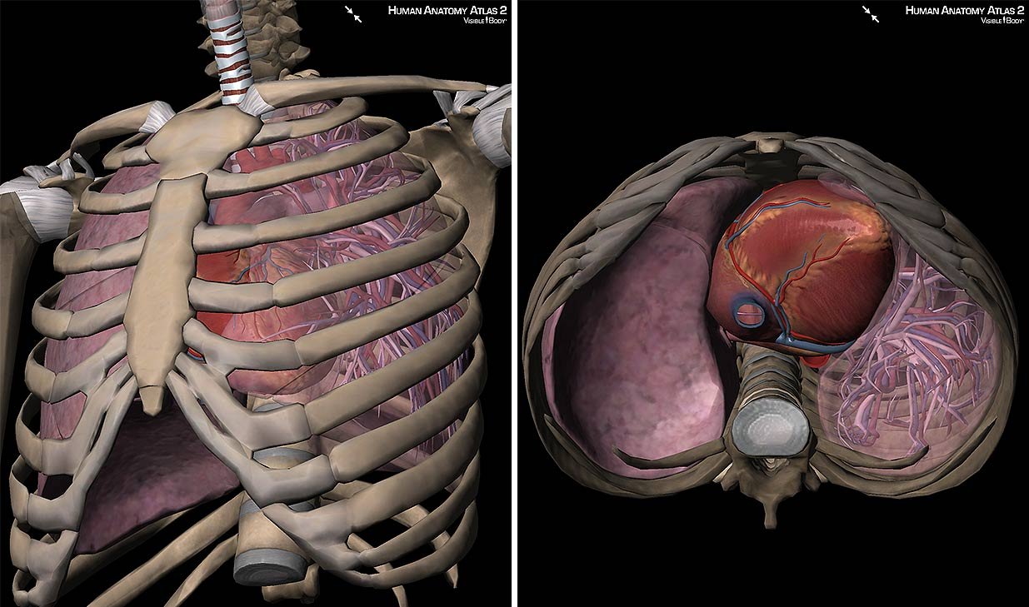
Thoracic Cavity – eclosed in ribs
Protects your heart
Protects your lungs

Slide 8
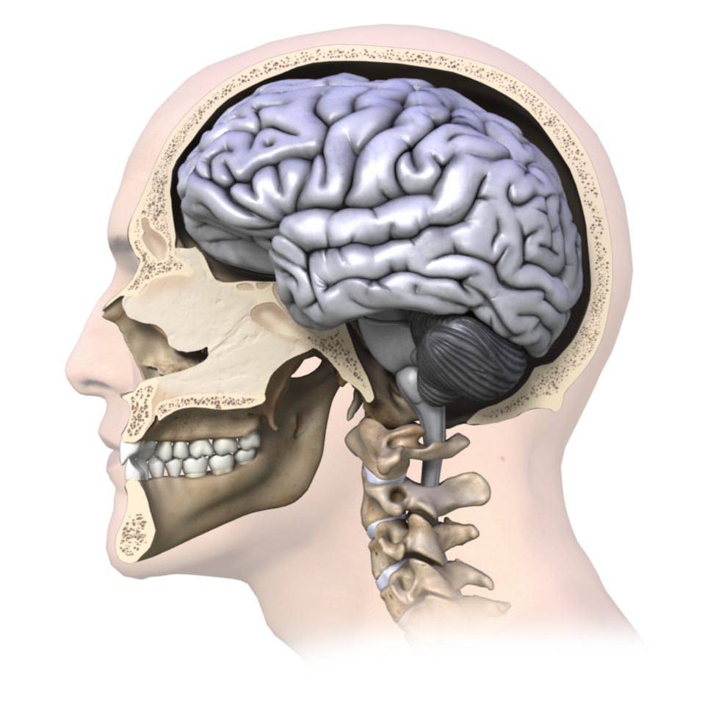
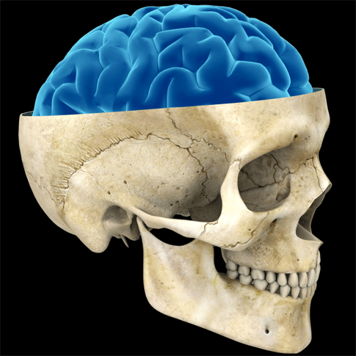
Skull
Protects your brain!

Slide 9
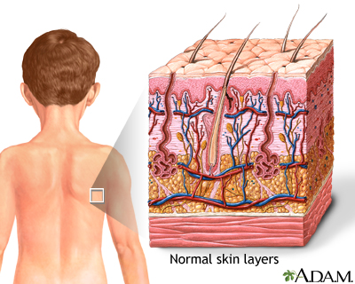
INTEGUMENTARY SYSTEM
The integumentary system includes the SKIN, which is the OUTER PROTECTIVE COVERING of the body
It is our body’s FIRST LINE OF
DEFENSE against injury.

Slide 10
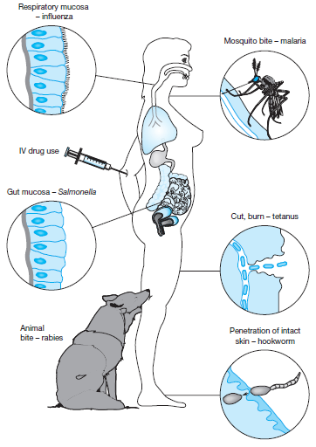
If pathogens do get into the body…
…the IMMUNE SYSTEM kicks in!

Slide 11
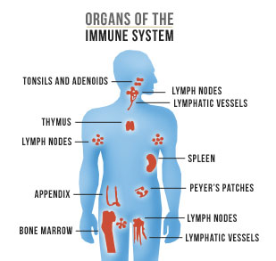
IMMUNE SYSTEM
Your immune system protects your body by detecting and fighting harmful things that invade your body.
The immune system includes: T-cells, lymph nodes, antibodies, etc.
The immune system works closely with the Circulatory system

Slide 12
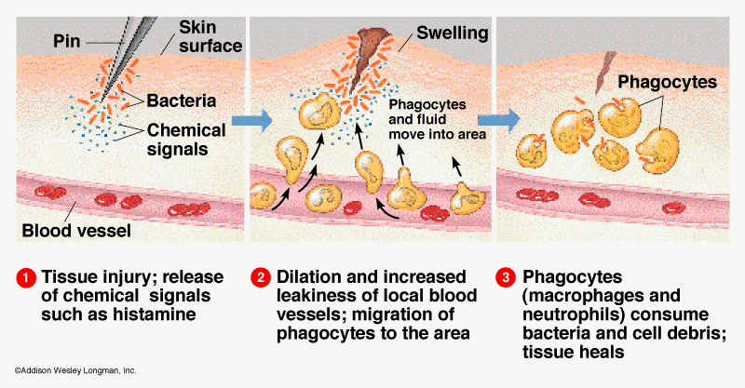
Inflammatory Response
FIRST immune response
Reaction to tissue damage
Nonspecific
Phagocytes engulf and destroy bacteria

Slide 13
Antigens & Antibodies
Antigens are foreign/toxic substances to the body that trigger the immune system response. (examples: virus, bacteria)
Antigens have a specific shape and trigger the production of ANTIBODIES, which find and mark (flag) the antigens for destruction.
Antigens=bad
Antibodies=good

Slide 14
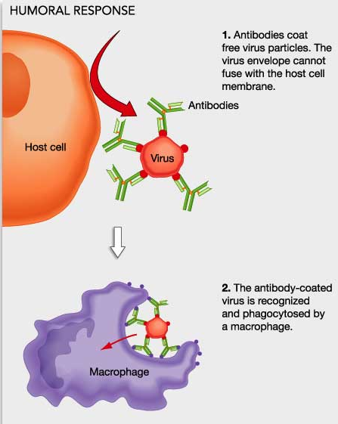

Slide 15
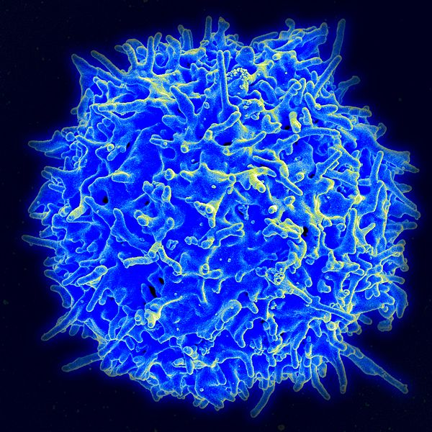
T-CELLS
T cells are white blood cells that mature in the THYMUS (hence the name ‘T’ cell)
Help fight against infections
Find and kill viruses

Slide 16
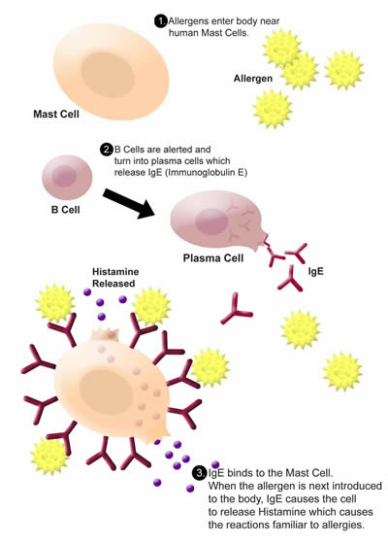
ALLERGIES
Allergic disorders occur when the immune system overreacts to exposure to antigens in the environment. The substances that provoke such attacks are called allergens.

Slide 17
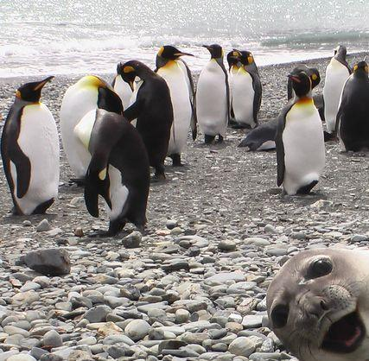
fridaaaaayyyyyyyyyy
On the back of your paper, write the important information about each bodily function (what systems are involved)
Make sure your DO NOWs from last week are turned in.
Make sure you submit your interactions powerpoints

