Slide 1
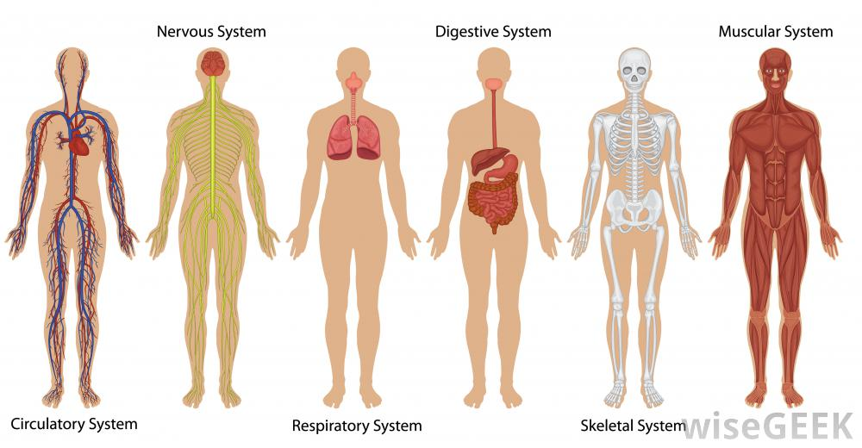
Body system interactions: regulation
EQ:
How do the body systems stay in balance?

Slide 2
OBJECTIVE
BIOL.10A Describe the interactions that occur among systems that perform the functions of regulation, nutrient absorption, reproduction, and defense from injury or illness in animals.

Slide 3
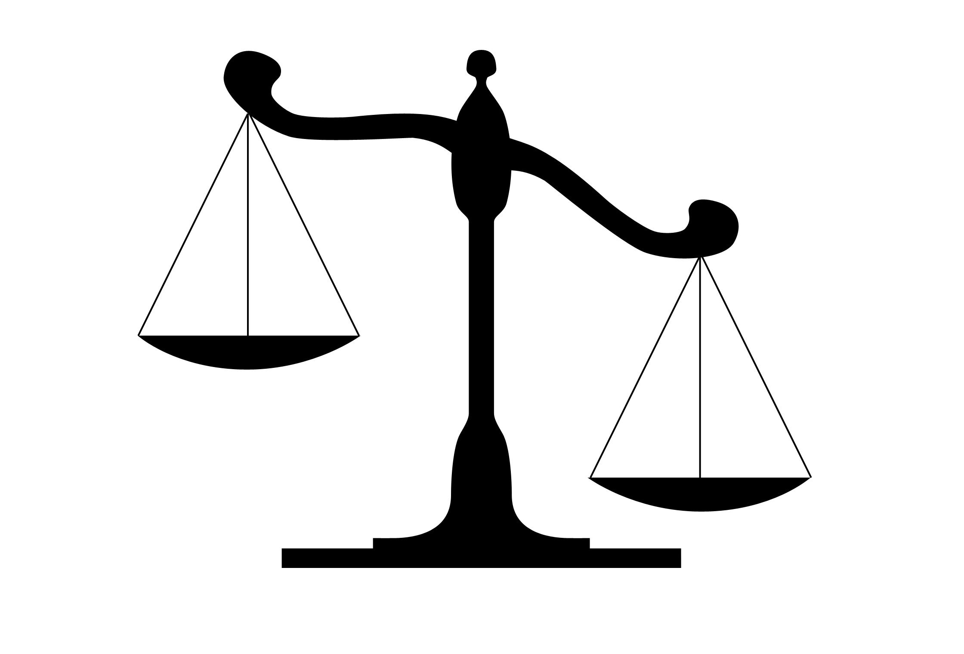
Cells must maintain homeostasis:
Homeostasis is a state of being in BALANCE
What must stay balanced in our bodies?

Slide 4
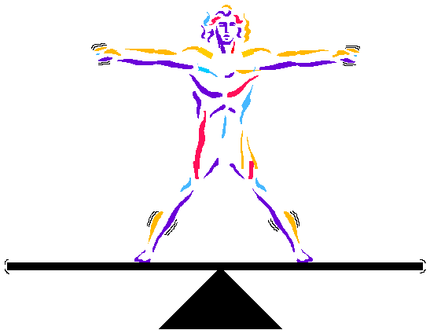
homeostasis
Cells maintain homeostasis by regulating (controlling) the:
temperature
pH (acidity)
Oxygen levels
Blood-glucose levels
Etc.

Slide 5
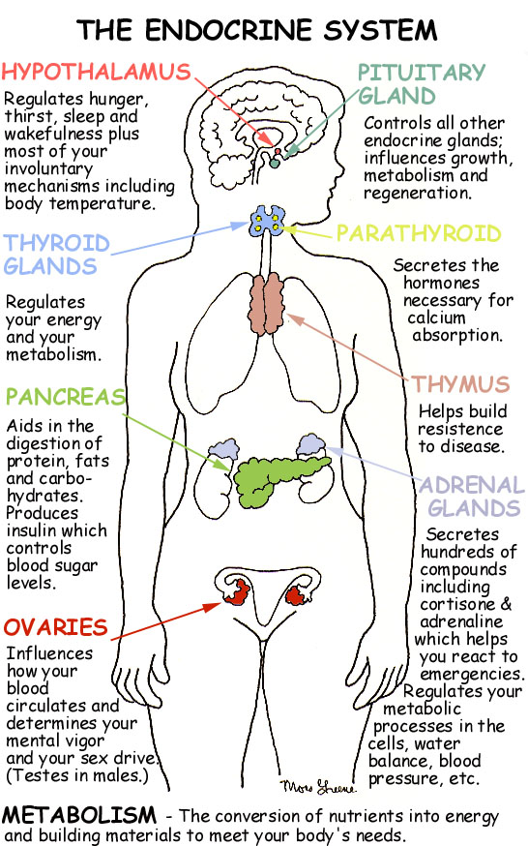
Endocrine system
The endocrine system includes all the hormones and hormone-producing glands in the body.

Slide 6
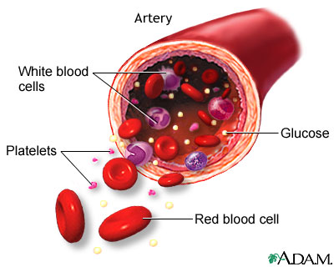
CIRCULATORY SYSTEM
Hormones are released into the blood stream,
and regulate all bodily functions
(Cellular metabolism, reproduction, sexual development, sugar and mineral homeostasis, heart rate, and digestion)

Slide 7
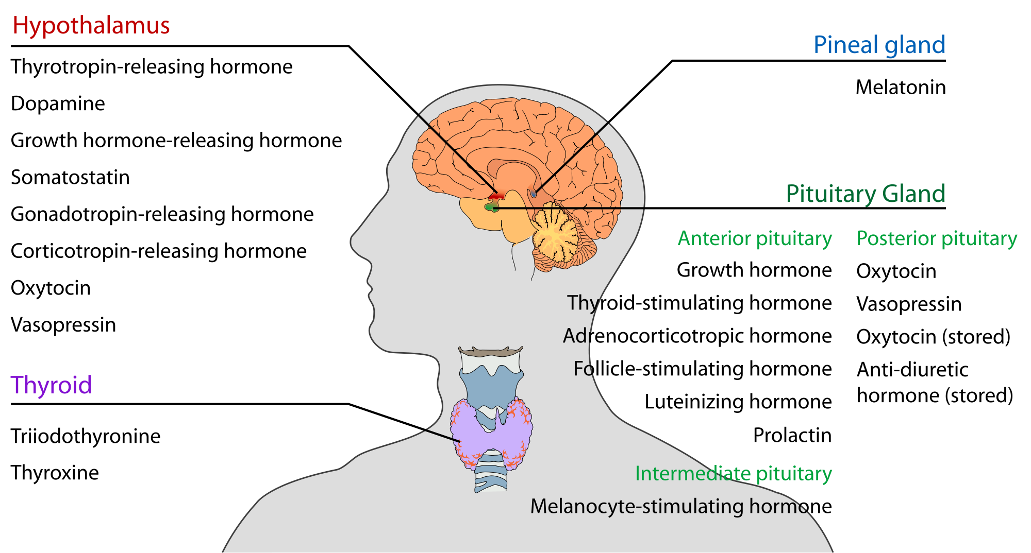
Nervous system
The brain and nerves help control movement and hormone production.

Slide 8
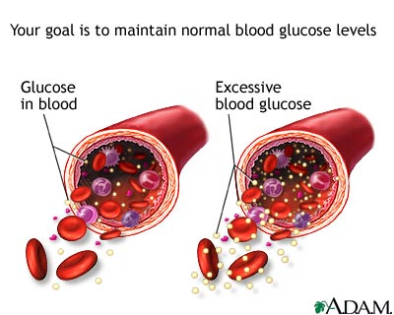
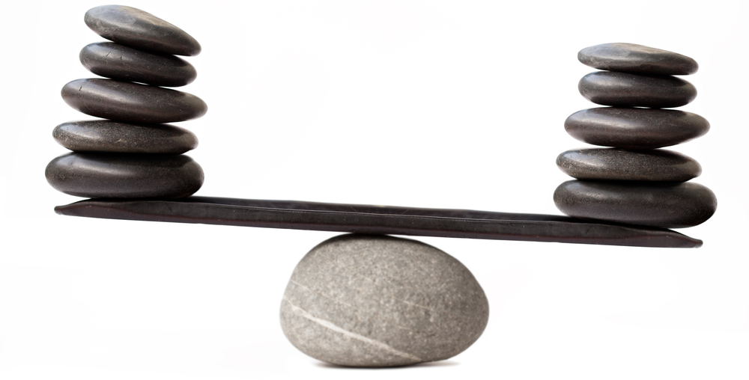
Negative feedback
A negative feedback system is one that tries to keep the body constant.
Example: Blood-glucose levels

Slide 9
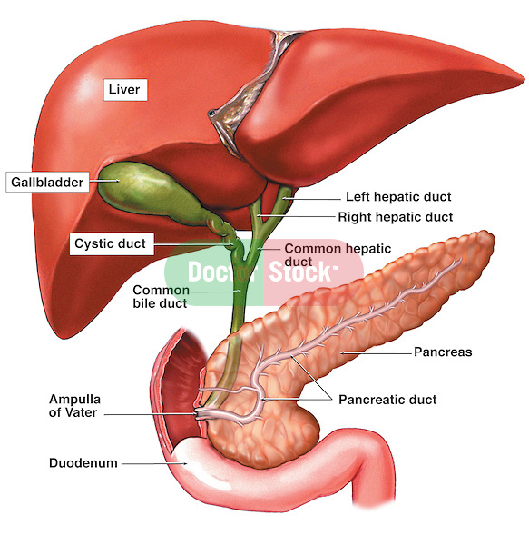
The liver stores glucose
The pancreas regulates the body’s blood –glucose levels by releasing insulin OR glucagon.

Slide 10
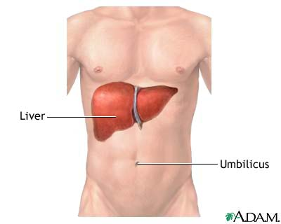
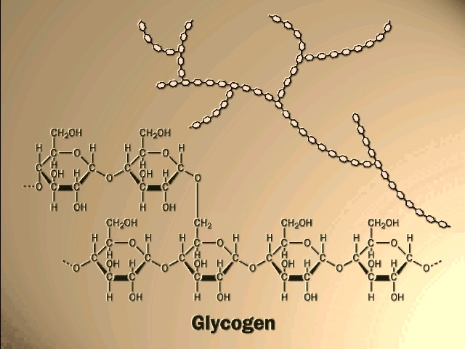
Glucose
In the liver, glucose is stored as Glycogen, a polysaccharide (made up of multiple glucose molecules)

Slide 11
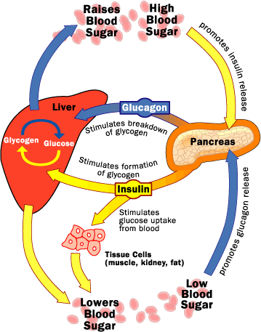
If blood sugar is high (after you eat), the pancreas will release INSULIN, which stimulates glycogen formation.

Slide 12
If blood sugar is low, the pancreas will release glucagon, which breaks down glycogen.
(glycogen breaks down into glucose → not there is more glucose in the blood)

Slide 13
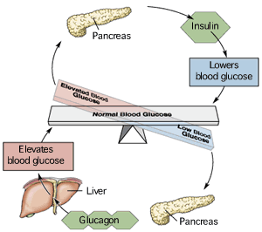
Regulation of glucose levels is like a teeter-totter. It switches off from high to low, always coming back to the middle.
→ equilibrium

Slide 14
Another example: temperature
Humans are homoeothermic, which means we regulate our own body temperature.
Other species like reptiles are not homoeothermic. They must warm up in the sun or cool down in water.
If your body gets too cold, a series of actions are taken to warm your body. Sensors throughout your nervous system can recognize when the temperature drops and might trigger your muscular system to start shivering. The constant contractions of your muscles allow heat to be generated. Your nervous and endocrine systems may also contract the blood vessels of your circulatory system to keep blood (and heat) in the core of your body and not the extremities(like fingers). This is why your fingers and toes get cold first!

Slide 15
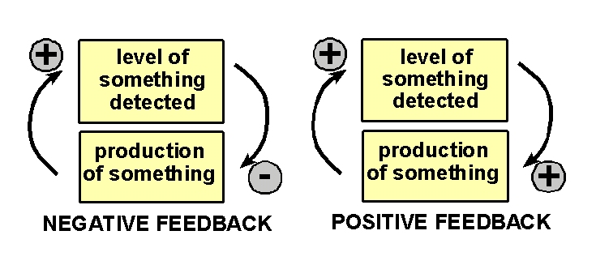
Positive feedback
In a positive feedback system the change will continue to increase in one direction until something happens in the body to stop it.
Example: childbirth

