Slide 1
2 types of cell division:
Mitosis VS Meiosis

Slide 2
Types of Cells:
The process of Differentiation produces different types of cells.
3 major types of cells:
Somatic Cells (regular Body Cells)
Gametes (“Germ cells” or “sex cells”)
Stem Cells (undifferentiated cells – can become any type of cell)

Slide 3
Somatic Cells (Body Cells)
Somatic Cells reproduce by undergoing MITOSIS
Both resulting cells are essentially identical (clones)
Parent cell and Daughter Cells are DIPLOID (2n), meaning they have 2 of each chromosome
(1 from Mom and 1 from Dad)
Mitosis is important for organismal growth and repair.
Mitosis also serves as ASEXUAL reproduction for Single-Celled Organisms.

Slide 4
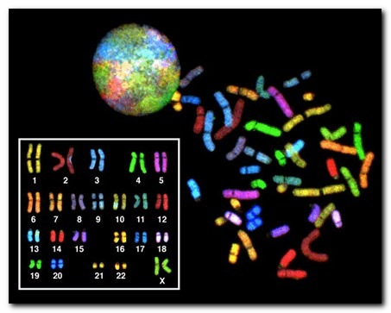
Human Chromosomes
Each human has 46 chromosomes in their somatic cells. 23 from Mom’s egg and 23 from Dad’s sperm.
Note: All 46 chromosomes replicate during S phase of Interphase, resulting in 92 strands of DNA!

Slide 5
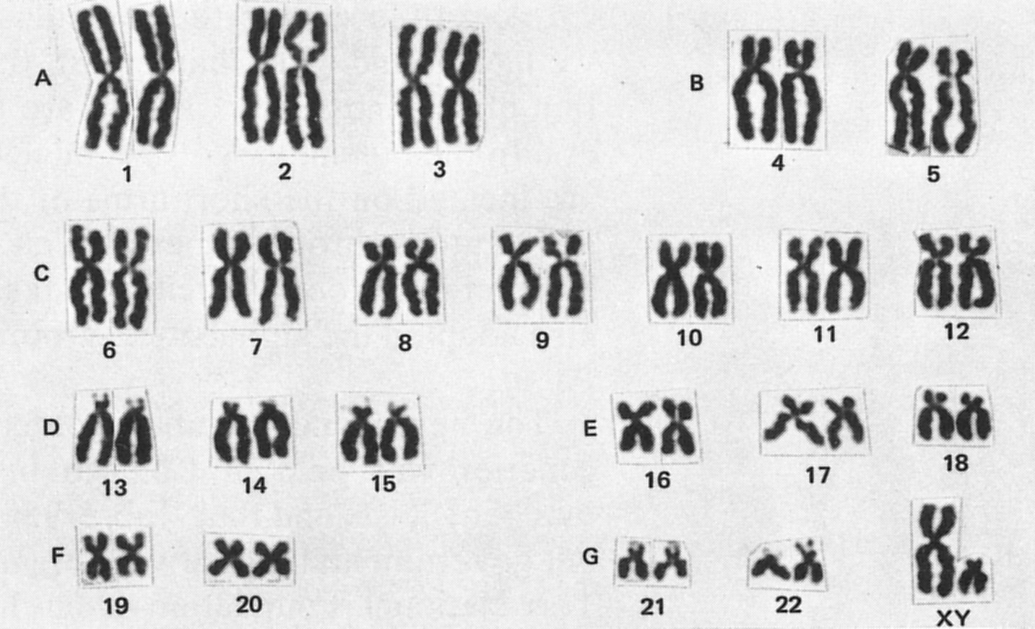
S-Phase of Interphase
DNA replication
Karyotype pictures are taken during Prophase, when chromosome pairs are condensed and easily seen.

Slide 6
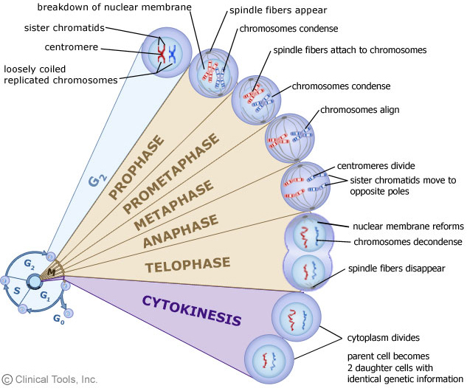

Slide 7
Germ Cells aka Gametes aka Sex Cells
Gametes are produced by the process of MEIOSIS. This process occurs in Eukaryotes.
Meiosis results in 4 Haploid Cells that are diverse.
Oogenesis: Produces Eggs (female gamete)
Spermatogenesis: Produces Sperm (Male gamete)
Each egg or sperm only contains half the number of chromosomes as normal, somatic cells. (haploid, n)→ one from Mom OR Dad of each chromosome

Slide 8
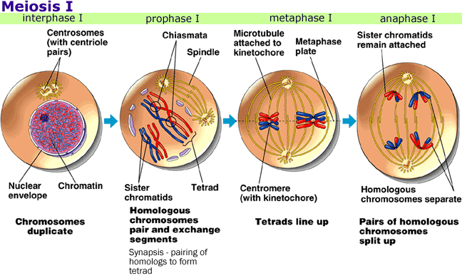
Meiosis I

Slide 9
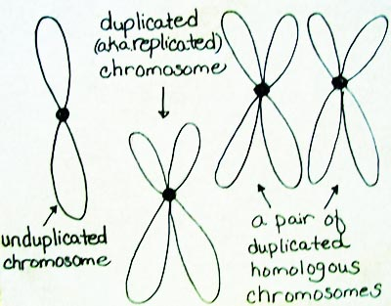
Homologous Chromosomes
A couple of homologous chromosomes is a set of one maternal chromosome and one paternal chromosome that pair up with each other inside a cell during Meiosis.
These copies have the same genes in the same locations
Homologous chromosomes (different than sister chromatids) separate during Anaphase 1 of Meiosis

Slide 10
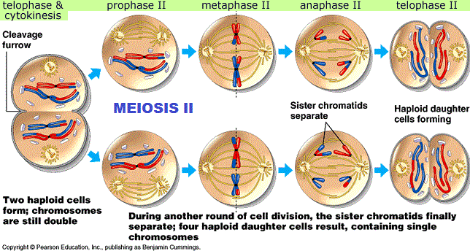
Meiosis II

Slide 11
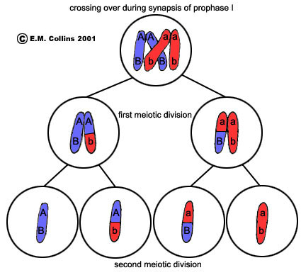
Prophase I of Meiosis
During Prophase 1 of Meiosis, something cool happens!
Synapsis → the pairing of homologous chromosomes.
Crossing-Over → when segments of chromatids with similar sequences break apart and are exchanged

Slide 12
Prophase I of Meiosis

