Slide 1
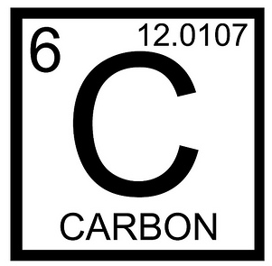
Biomolecules: FUNCTIONS
Objective: compare/contrast the 4 biomolecules’ structures and FUNCTIONS
Molecules are groups of atoms
Organic Molecules are molecules that contain CARBON
There are 4 organic molecules that are present in ALL living things:
1. Carbohydrates
2. lipids
3. Proteins
4. Nucleic Acids

Slide 2
Major Functions:
Carbohydrates are used for short term ENERGY STORAGE.
(e.g.,sugars and starches)

Slide 3
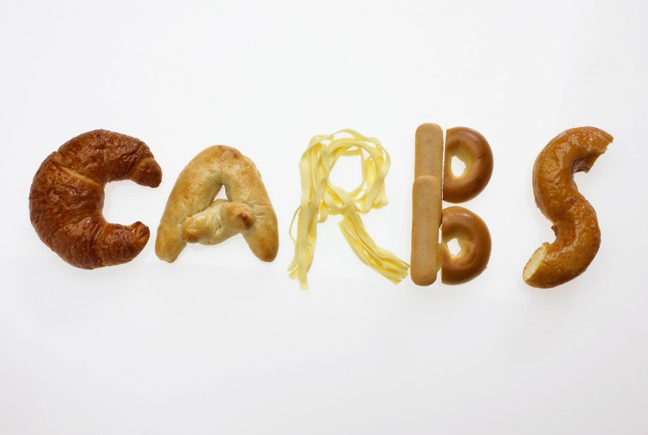
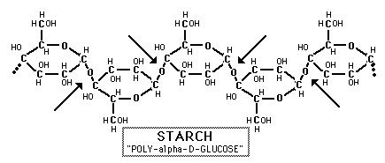
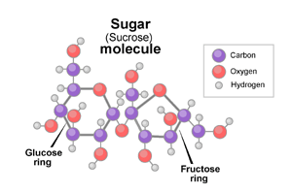
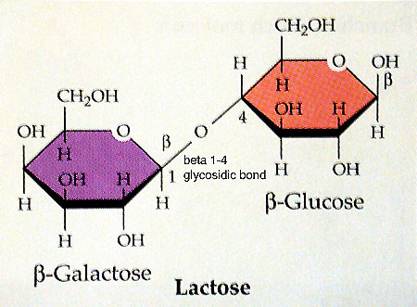
Carbohydrates aka carbs (made up of sugars)

Slide 4
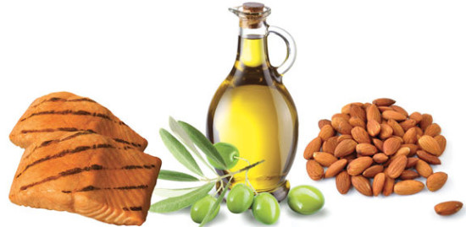
Major Functions:
Carbohydrates are used for short term ENERGY STORAGE.
(e.g.,sugars and starches)
Lipids are used for long term ENERGY STORAGE and CELL MEMBRANE STRUCTURE
(e.g., fats and phospholipids)

Slide 5
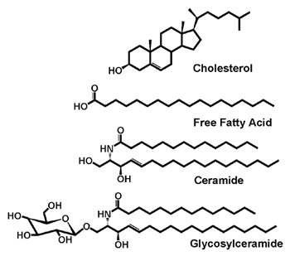
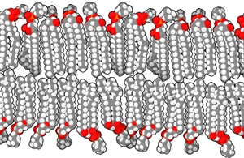
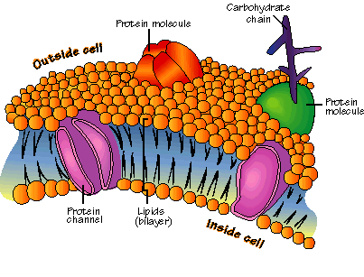
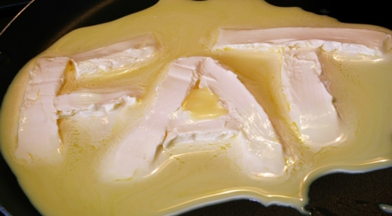
LIPIDS AKA FATS

Slide 6
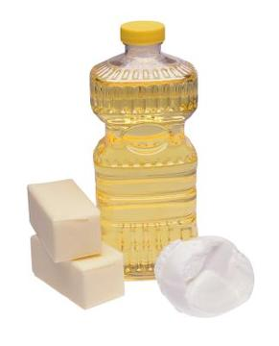
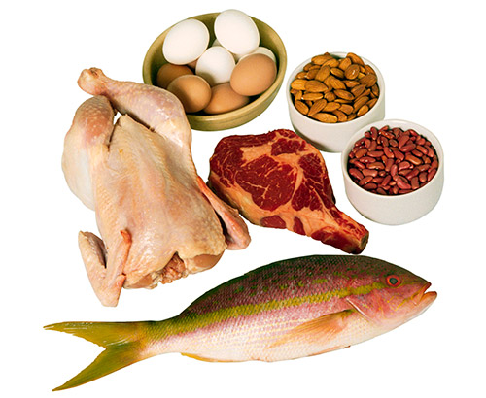
Major Functions:
Carbohydrates are used for short term ENERGY STORAGE.
(e.g.,sugars and starches)
Lipids are used for long term ENERGY STORAGE and CELL MEMBRANE STRUCTURE
(e.g., fats and phospholipids)
Proteins are used for STRUCTURE, CELL TRANSPORT, CATALYZING REACTIONS (enzymes)
(e.g., keratin and lactase)

Slide 7
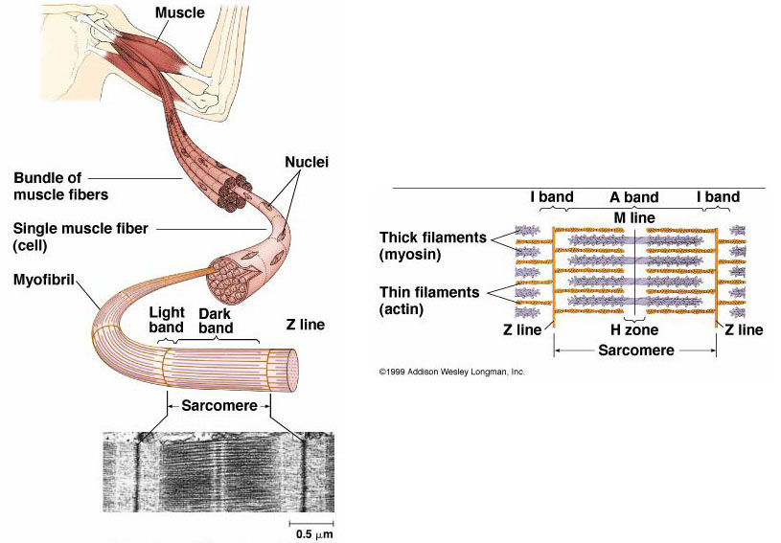
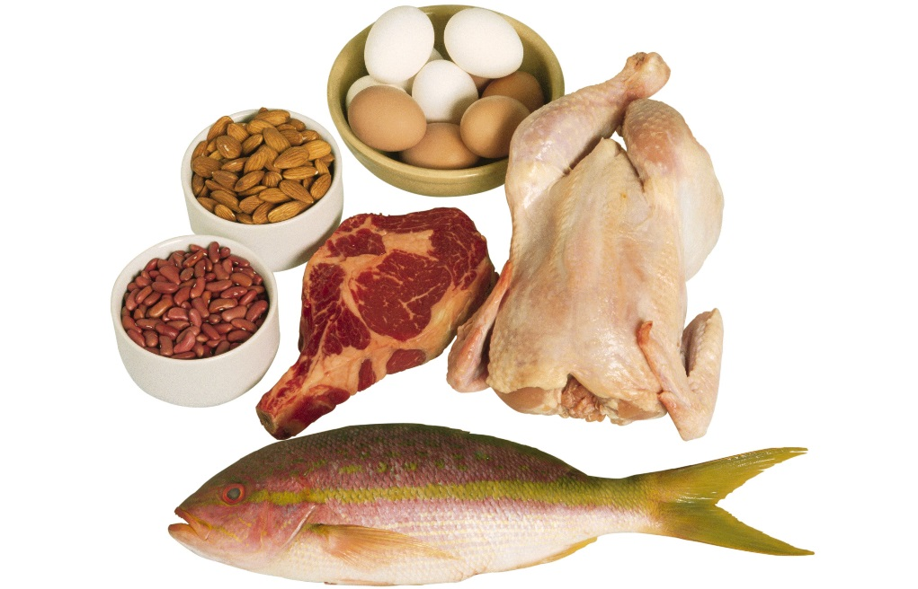
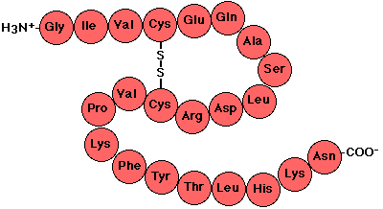
Proteins:

Slide 8
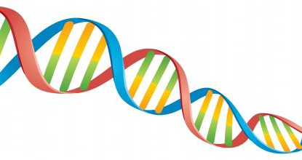
Major Functions:
Carbohydrates are used for short term ENERGY STORAGE.
(e.g.,sugars and starches)
Lipids are used for long term ENERGY STORAGE and CELL MEMBRANE STRUCTURE
(e.g., fats and phospholipids)
Proteins are used for STRUCTURE, CELL TRANSPORT, CATALYZING REACTIONS (enzymes)
(e.g., keratin and lactase)
Nucleic Acids are used for STORING INFORMATION
(e.g., DNA and RNA)

Slide 9
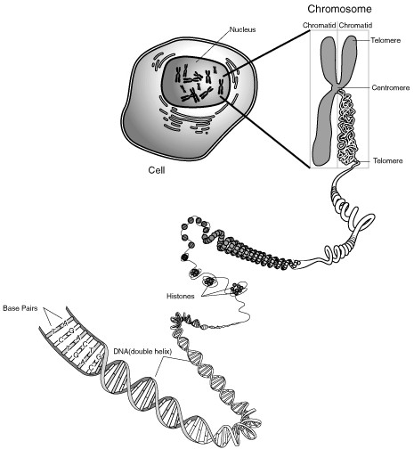
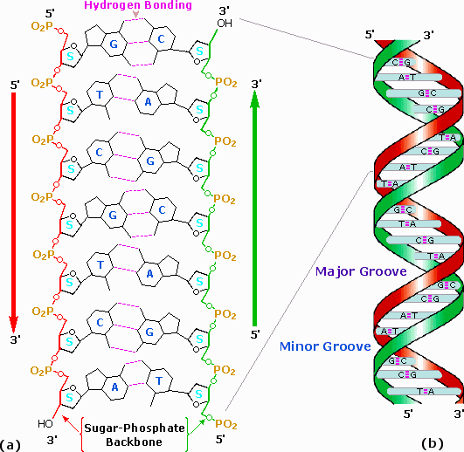
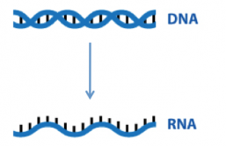
Nucleic acid

Slide 10
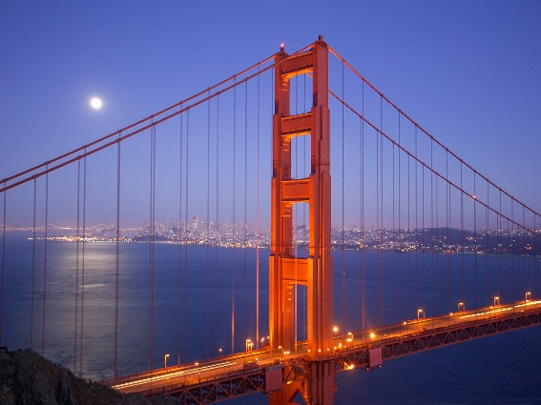
Biomolecular Structure
What are the building blocks of the 4 biomolecules?
Structure = arrangement; what something is made of
Structure→function

Slide 11
Biomolecules are polymers.
Polymers are made up of monomers
Monomer = one small unit that makes up a polymer
Polymer = many monomers stuck together
Mono = ‘one’
Poly = ‘many’

Slide 12
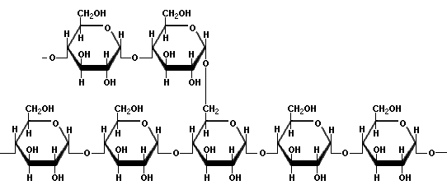
Carbohydrate Structure
Monomer = monosaccharide
(aka simple sugars)
Example: glucose, fructose
Polymer = Disaccharide
Example: sucrose (table sugar)
Polymer = polysaccharide
Example: Starch

Slide 13
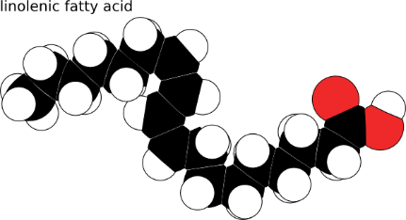
2. Lipid Structure
Monomer = fatty acids
Long chains of Carbon with Hydrogens attached
Polymer =Lipid
Example: Phospholipid

Slide 14
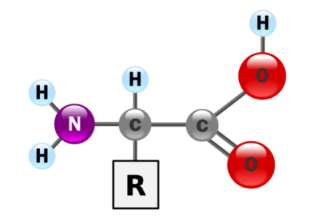
3. Protein Structure
Monomer = amino acid
(there are 20 different a.a.)
Polymer = Polypeptide
~Amino acids connected by peptide bonds
Polymer = Protein
~folded/twisted polypeptides

Slide 15
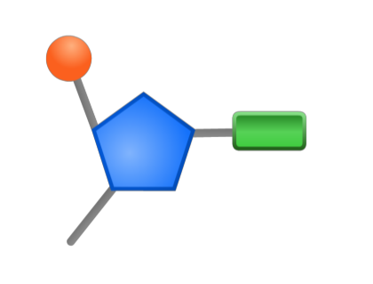
Nucleic Acid Structure
Monomer = nucleotide
Polymer =Nucleic Acid
Example: DNA, RNA

Slide 16
Monosaccharide
Amino Acid
Fatty
Acid
Nucleotide

Slide 17
Exit Ticket:
Monosaccharides make up __________________
Fatty acids make up _______________________
Amino Acids make up _______________________
Nucleotides make up ________________________

